Slide 1
Values & Action: Do more people care than we think?
Today we will be exploring what you and the people around you care about

Slide 2
Do we live in a selfish world? How do we see the people around us?
Notes:
Image is hyperlinked or go to: https://www.youtube.com/watch?v=HK1vwlvccCw

Slide 3
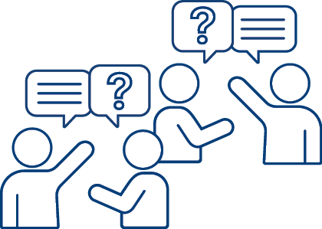
How did this video make you feel?
Discuss with your neighbour

Slide 4
From the video:
On a scale of 1-5, how much do you agree or disagree with the following statement?
“I keep my thoughts within my head”
Strongly disagree
Strongly agree
Disagree
Neutral
Agree

Slide 5
From the video:
On a scale of 1-5, how much do you agree or disagree with the following statement?
“People are naturally selfish”
Strongly disagree
Strongly agree
Disagree
Neutral
Agree

Slide 6
From the video:
On a scale of 1-5, how much do you agree or disagree with the following statement?
“I don’t feel I have the power or the strength to say something about it”
Strongly disagree
Strongly agree
Disagree
Neutral
Agree

Slide 7
From the video:
On a scale of 1-5, how much do you agree or disagree with the following statement?
“I keep my thoughts within my head”
“I need more courage”
Strongly disagree
Strongly agree
Disagree
Neutral
Agree

Slide 8
The video showed that there’s a difference between what we think other people care about and what they really do care about.
We think only 33 out of 100 people care (33%)
Really 84 out of 100 people care (84%)
This is called the Values Perception Gap

Slide 9
What are values?
Discuss with your neighbour.
Can you think of any examples?

Slide 10
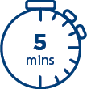
Using your worksheet, you have 5 minutes to circle 10 values that you feel are most important to you
You now have just 1 minute to reduce your list to only 5 values
You now have just 30 seconds to choose your top 3 values

Slide 11
Stick your top three values on the board
Are there any similarities?
Seeing all these values, how does it make you feel?
As a class, choose your top four values

Slide 12
How do values work?

Slide 13
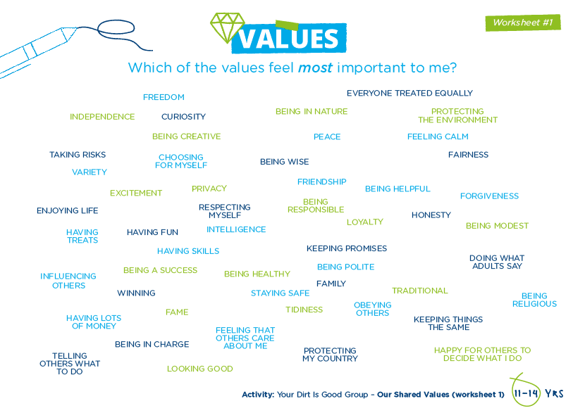

Slide 14
We all hold all of these values
But at different times we place more importance on some than on others and use some more than others too.
Can you think of a time you’ve placed more importance on one of these values than another?

Slide 15
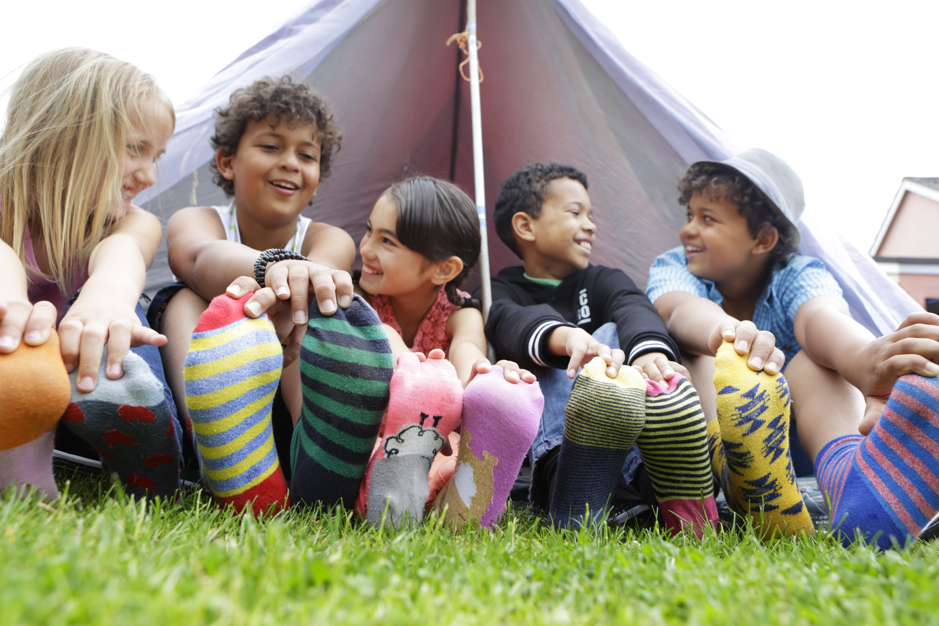
How do values work?
Values are like muscles
The more you exercise a value by using it, the stronger it becomes!
Like going for a jog – the more you run, the stronger your legs will become!

Slide 16
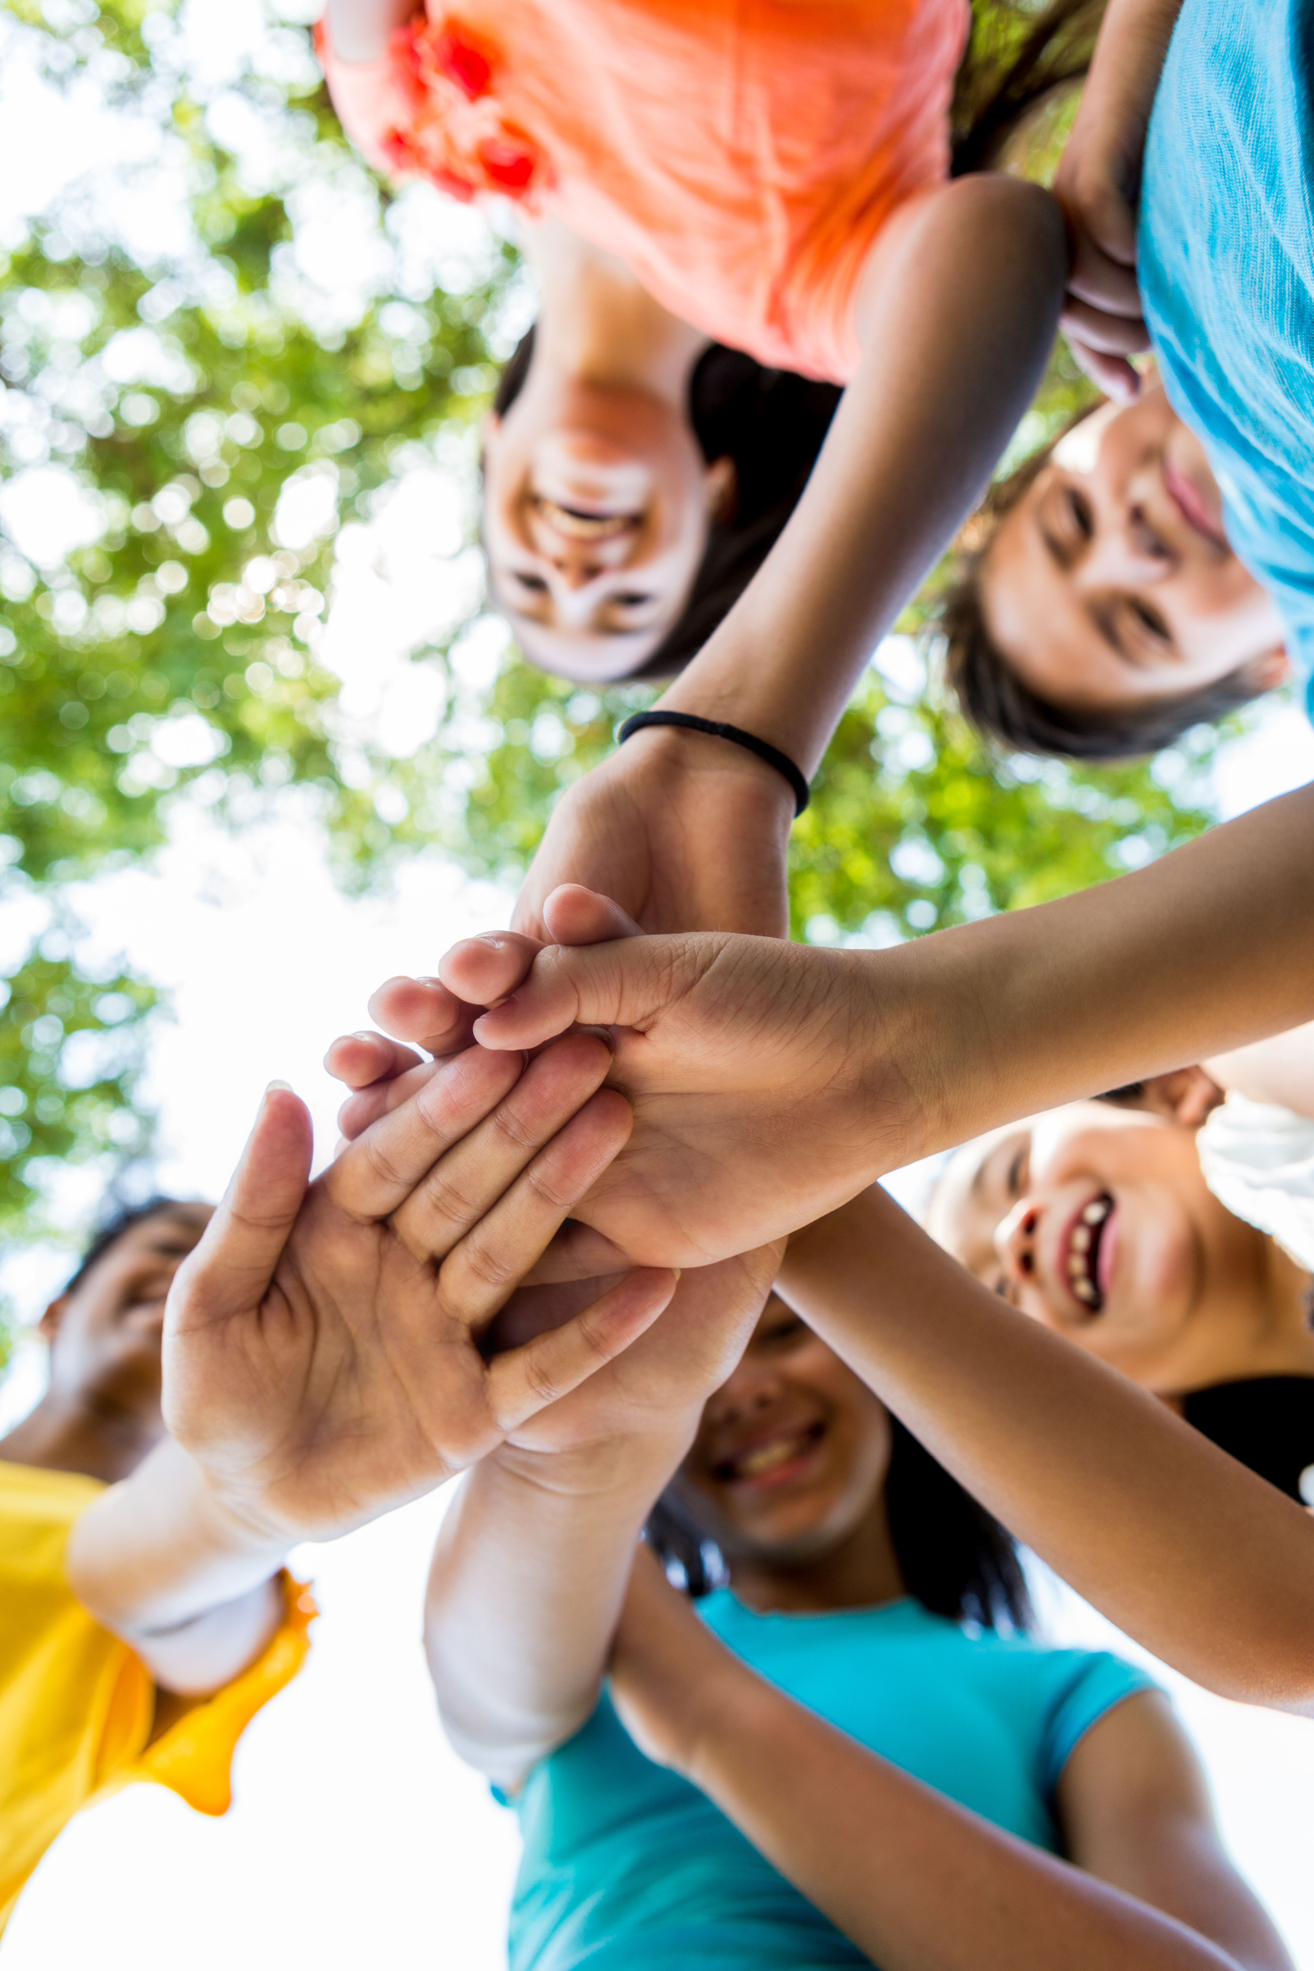
How do values work?
Values have a knock-on effect
When you act on a value, you also strengthen other values that are nearby on the map.
Like jogging - you are strengthening your legs, but you are also strengthening other parts of your body too.

Slide 17
How do values work?
Values act a bit like a see-saw!
When you exercise and strengthen one value by acting on it, the opposite values get weaker.
Being kind
Being mean

Slide 18
Finding our shared values
Use the class top four values to complete the worksheet
Notes:
Hand out the worksheet and explain that the top 4 group values will guide the class from now on.
In pairs, invite them to write down the collective values in each of the boxes.
Ask each pair to discuss these values, why they’re important, and how the group can live and demonstrate them. You may want to do one together e.g. kindness is important as it is important to treat people fairly. We can do this by helping if others are stuck.
When finished, recap their ideas together as one group.

Slide 19
Finding our shared values
Use the class top four values to complete the worksheet

Slide 20
One small change
What one small change will you make to nurture compassionate values and help others see that people care more than we might think?
Write or draw your promise onto the template.
Notes:
Hand out the worksheet and explain that the top 4 group values will guide the class from now on.
In pairs, invite them to write down the collective values in each of the boxes.
Ask each pair to discuss these values, why they’re important, and how the group can live and demonstrate them. You may want to do one together e.g. kindness is important as it is important to treat people fairly. We can do this by helping if others are stuck.
When finished, recap their ideas together as one group.

Slide 21
Have your feelings changed today after this session?
Answer the following questions again…

Slide 22
From the video:
On a scale of 1-5, how much do you agree or disagree with the following statement?
“I keep my thoughts within my head”
Strongly disagree
Strongly agree
Disagree
Neutral
Agree

Slide 23
From the video:
On a scale of 1-5, how much do you agree or disagree with the following statement?
“People are naturally selfish”
Strongly disagree
Strongly agree
Disagree
Neutral
Agree

Slide 24
From the video:
On a scale of 1-5, how much do you agree or disagree with the following statement?
“I don’t feel I have the power or the strength to say something about it”
Strongly disagree
Strongly agree
Disagree
Neutral
Agree

Slide 25
From the video:
On a scale of 1-5, how much do you agree or disagree with the following statement?
“I keep my thoughts within my head”
“I need more courage”
Strongly disagree
Strongly agree
Disagree
Neutral
Agree

Slide 26
If your score has gone down, it shows that you’re beginning to realise that you’re not alone…
…and showing others your compassion through acting on your pledge will help other people realise they too are not alone

Slide 27
Visit the Dirt Is Good website here: www.dirtisgoodproject.com

